Slide 1


HOUSE PRIZE PREDICTION MODEL
Submitted by : Bhushan Kumar Sharma
Designation: Intern Data Scientist
Company : Flip Robo Technologies

Slide 2
Problem Statement
Houses are one of the necessary need of each and every person around the globe and therefore housing and real estate market is one of the markets which is one of the major contributors in the world’s economy. It is a very large market and there are various companies working in the domain. Data science comes as a very important tool to solve problems in the domain to help the companies increase their overall revenue, profits, improving their marketing strategies and focusing on changing trends in house sales and purchases. Predictive modelling, Market mix modelling, recommendation systems are some of the machine learning techniques used for achieving the business goals for housing companies. Our problem is related to one such housing company.

Slide 3
Problem Statement
A US-based housing company named Surprise Housing has decided to enter the Australian market. The company uses data analytics to purchase houses at a price below their actual values and flip them at a higher price. For the same purpose, the company has collected a data set from the sale of houses in Australia. The data is provided in the CSV file below. The company is looking at prospective properties to buy houses to enter the market. You are required to build a model using Machine Learning in order to predict the actual value of the prospective properties and decide whether to invest in them or not. For this company wants to know:
Which variables are important to predict the price of variable?
How do these variables describe the price of the house

Slide 4
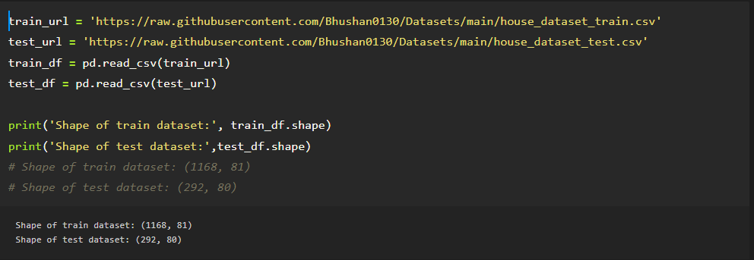
Loading dataset
Two dataset has loaded one is for training and second is for to predict house prize

Slide 5
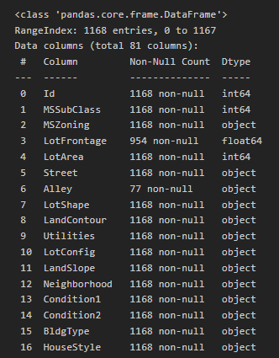
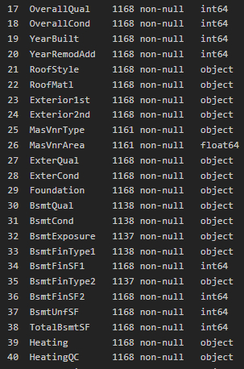
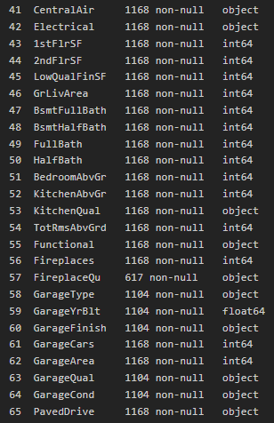
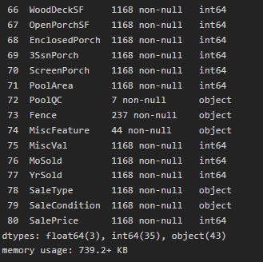
Information of dataset
Complete information one can see in this output of information, null values are present in the dataset as few column are having very less non-null value

Slide 6
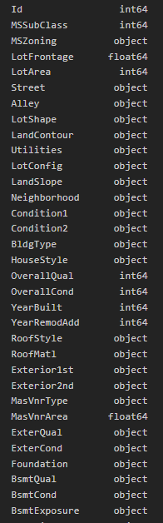
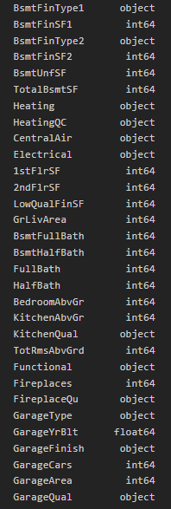
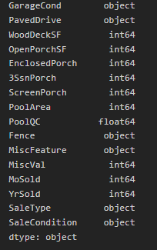
Datatype of feature
Majority of column are of object type

Slide 7
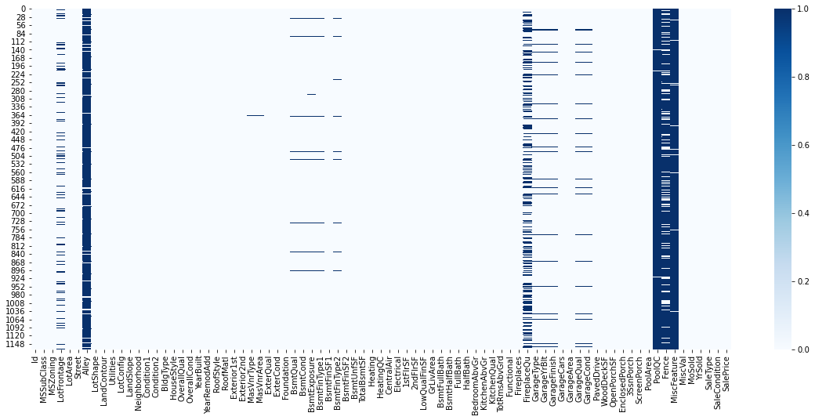
Checking null values
Train dataset is having so many null values, need to work on it

Slide 8
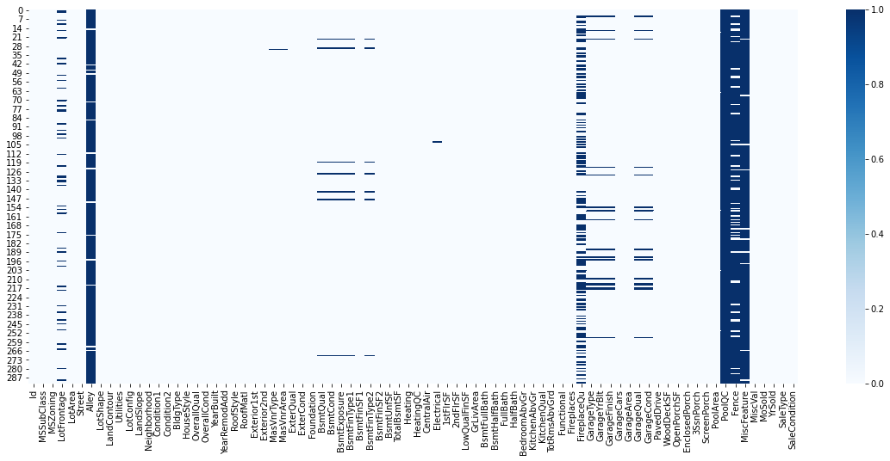
Checking null values
Test dataset is also having so many null values, accordingly have to perform operation of imputation

Slide 9
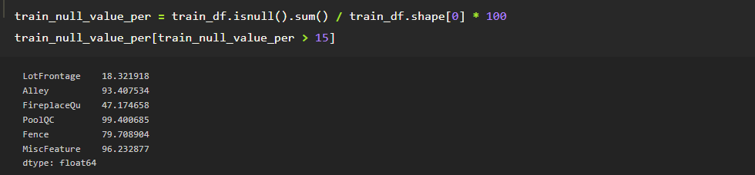
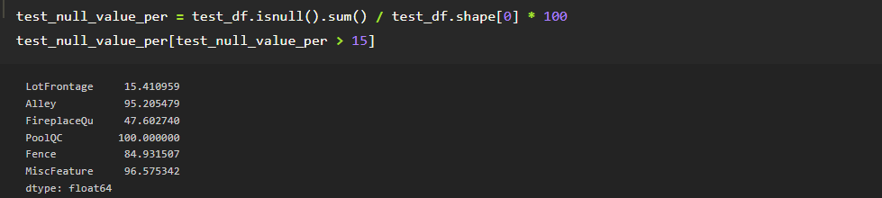
Removing null values
If a column is having more than 15% null values then it is better to remove these columns, therefore I have removed these above mentioned columns

Slide 10
Removing null values
Same operation done with test dataset, hence removed above mentioned columns

Slide 11
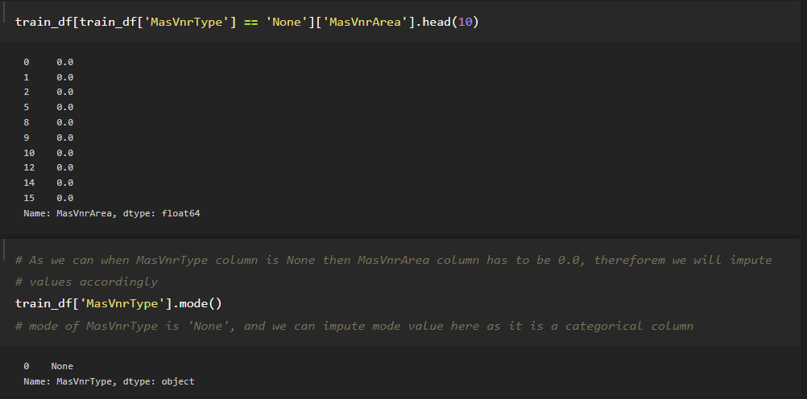
Removing null values
Checked relation between different columns then impute values accordingly for many categorical columns of the dataset.
Mainly impute mode value of the column for categorical columns

Slide 12
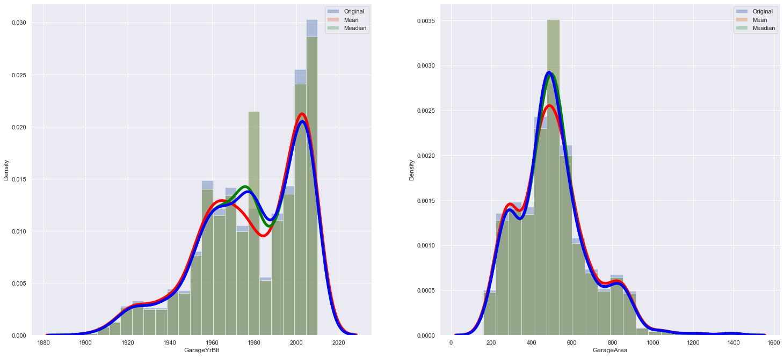
Removing null values
Median and Mean imputation effect on columns, are shown above
If column is skewed then it is better to impute Median value instead mean

Slide 13
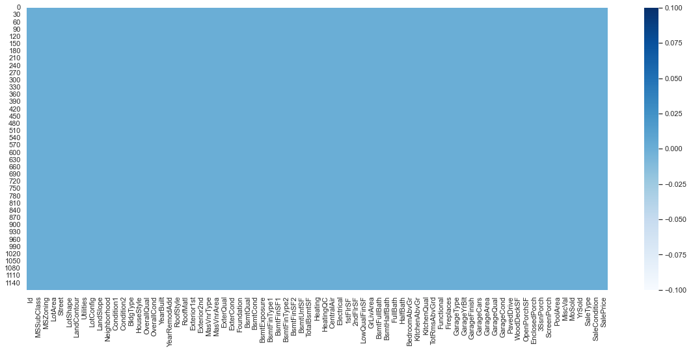
Checking null values
For Train Dataset: As graph is clean now, which indicate that, now no null value present in the train dataset

Slide 14
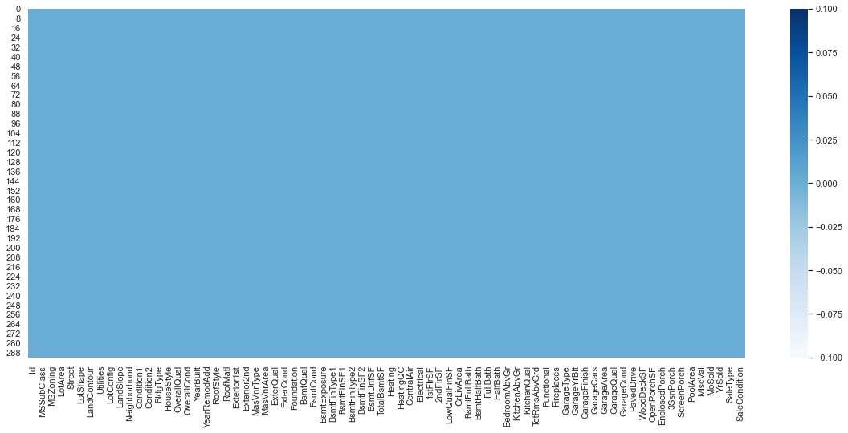
Checking null values
For Test dataset: As graph is clean now, which indicate that, now no null value present in the train dataset

Slide 15
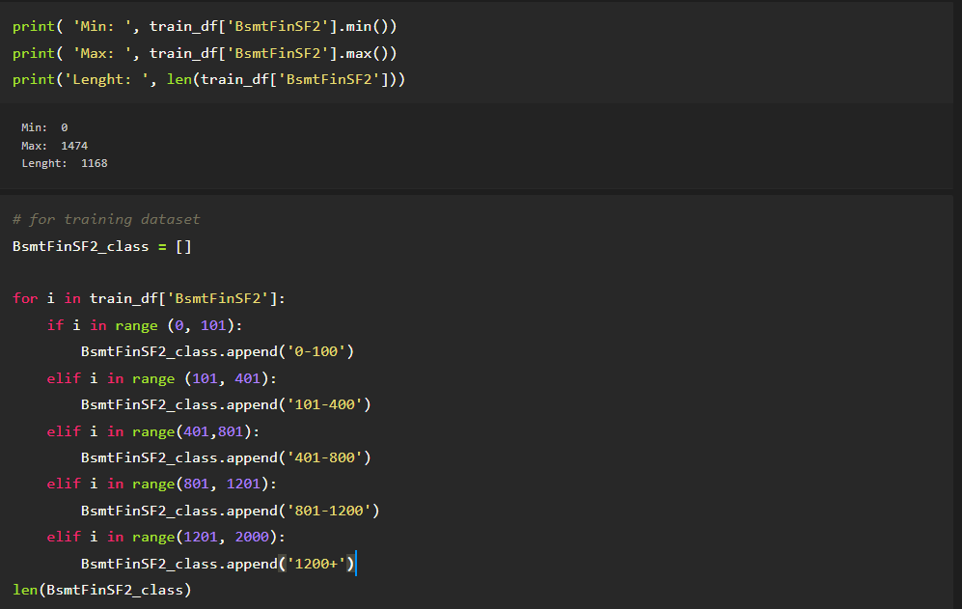
Data Preprocessing

Slide 16
Data Preprocessing
# BsmtFinSF1
# BsmtFinSF2
# LowQualFinSF
# EnclosedPorch
# 3SsnPorch
# ScreenPorch
# PoolArea
# MiscVal

Slide 17
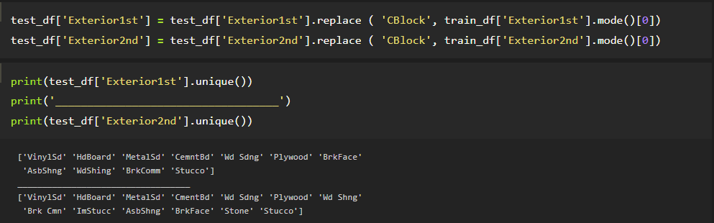
Data Preprocessing
Hick:

Slide 18
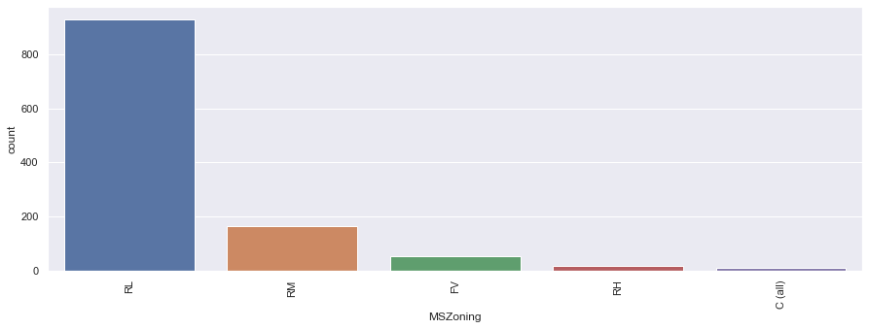
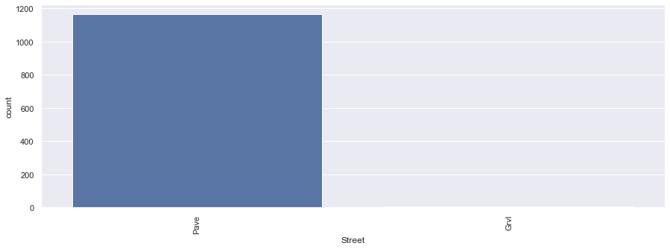
Visualization

Slide 19
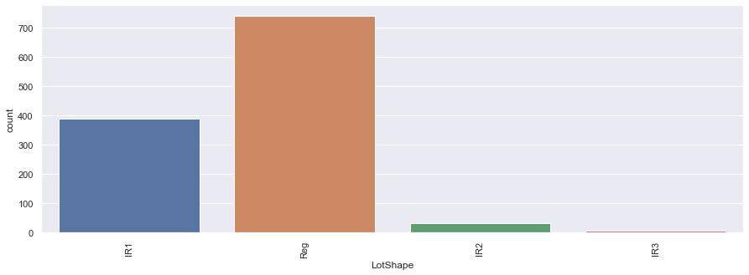
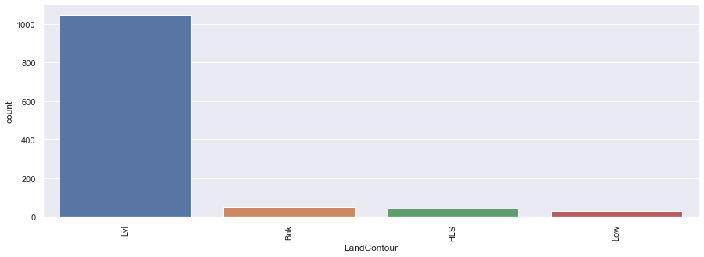
Visualization

Slide 20
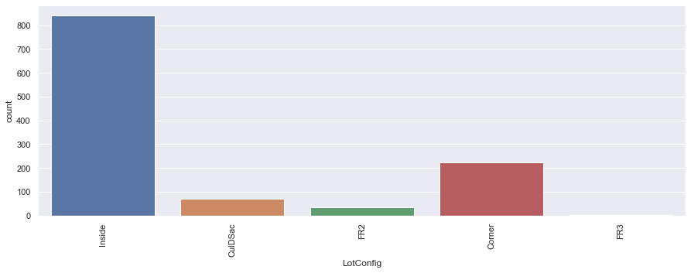
Visualization

Slide 21
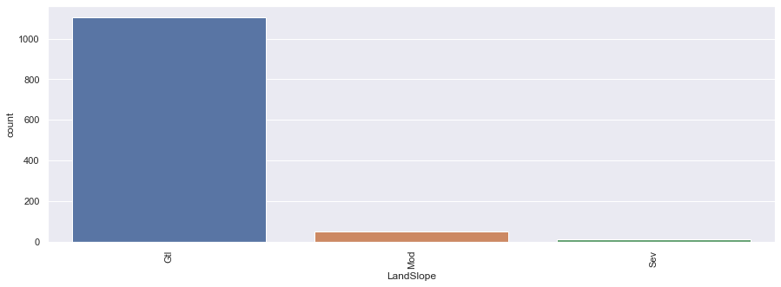
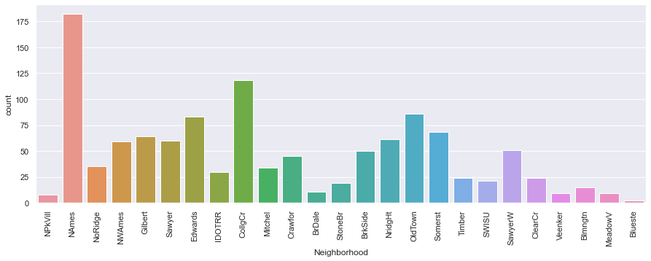
Visualization

Slide 22
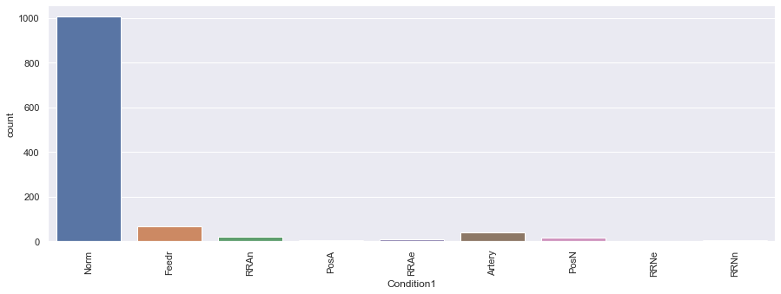
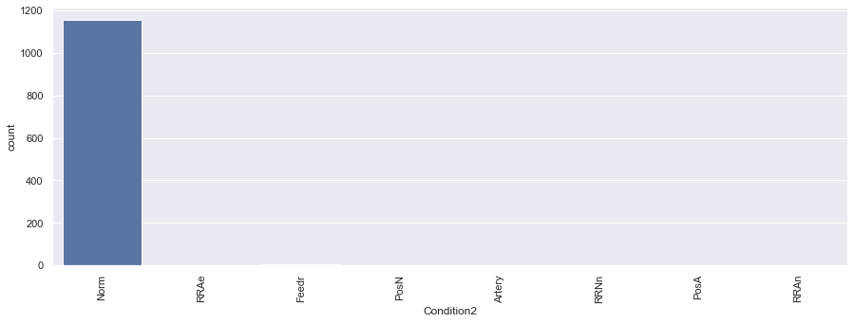
Visualization

Slide 23
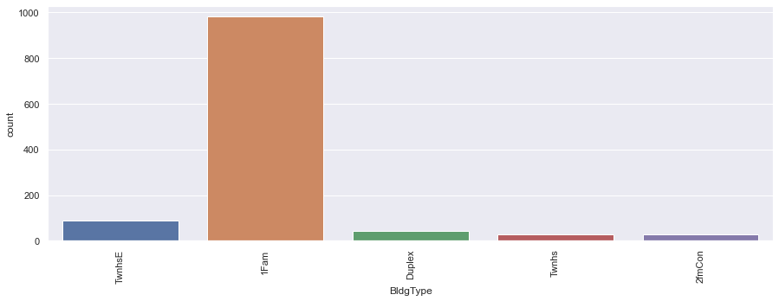
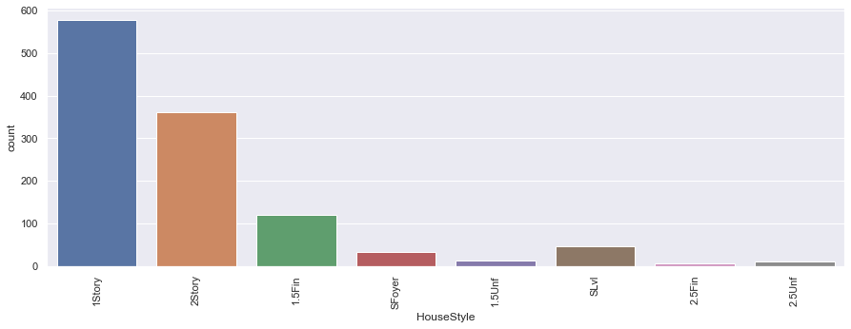
Visualization

Slide 24
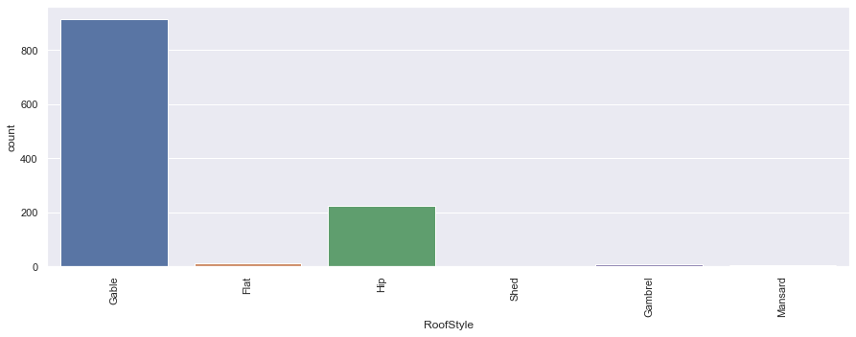
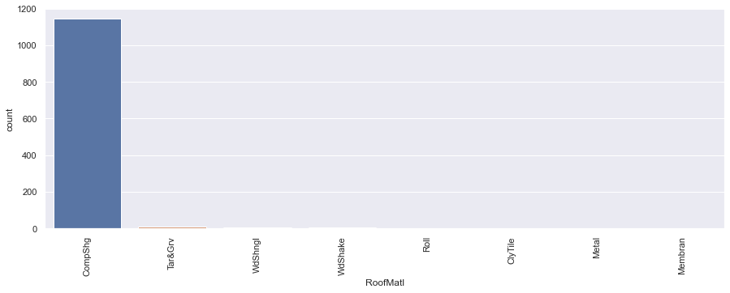
Visualization

Slide 25
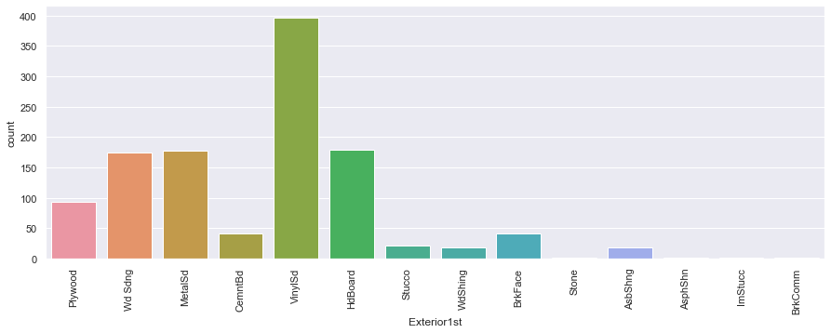
Visualization

Slide 26
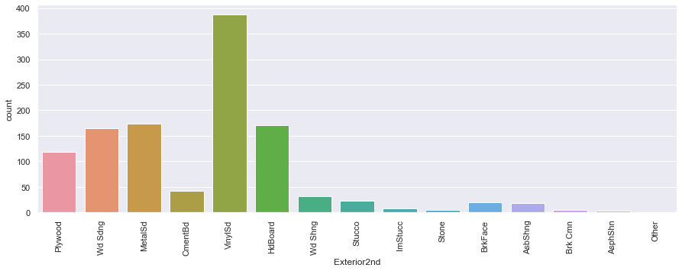
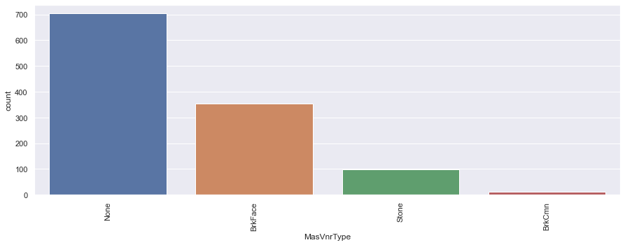
Visualization

Slide 27
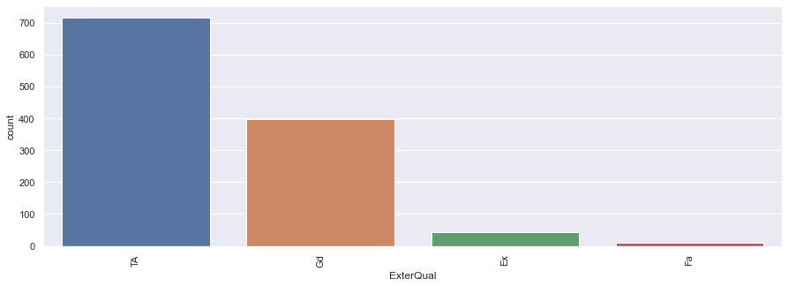
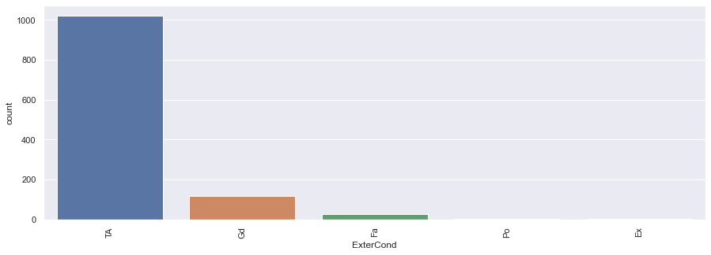
Visualization

Slide 28
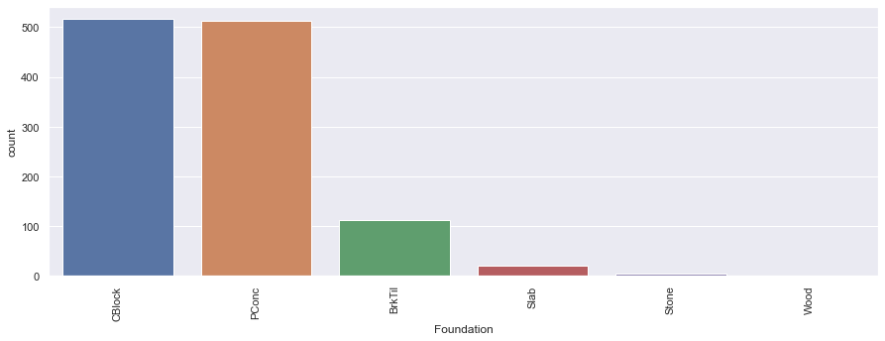
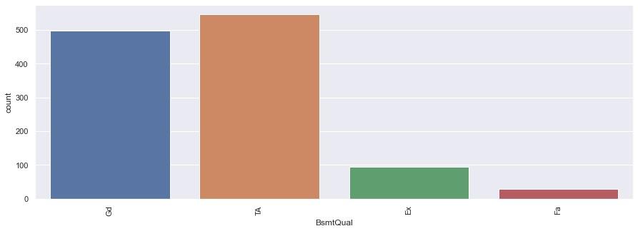
Visualization

Slide 29
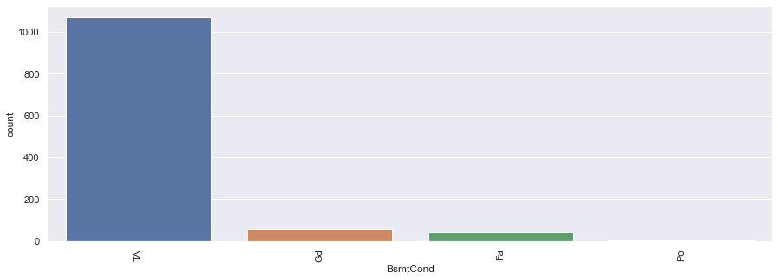
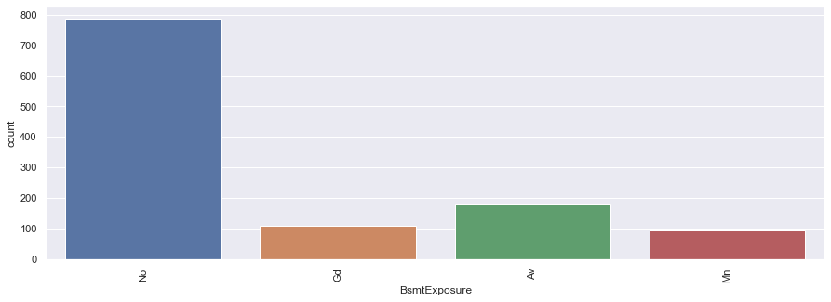
Visualization

Slide 30
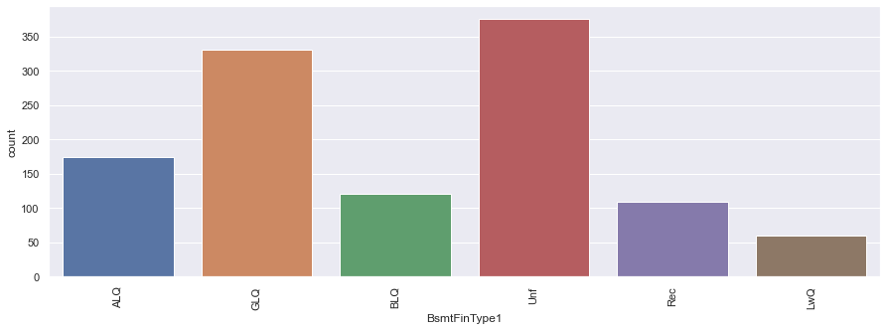
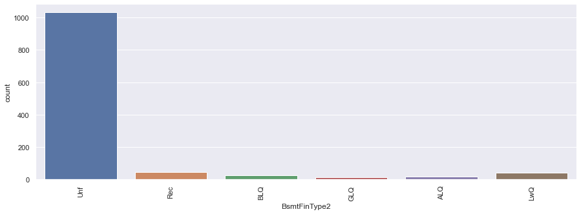
Visualization

Slide 31
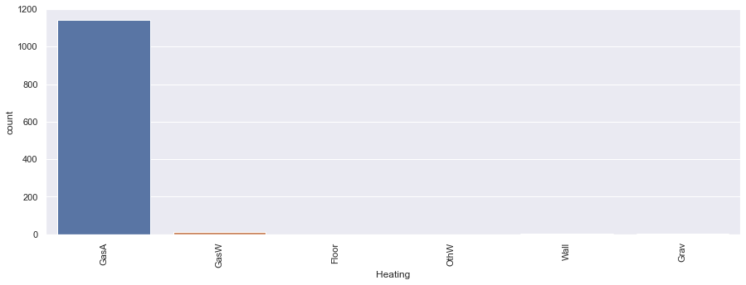
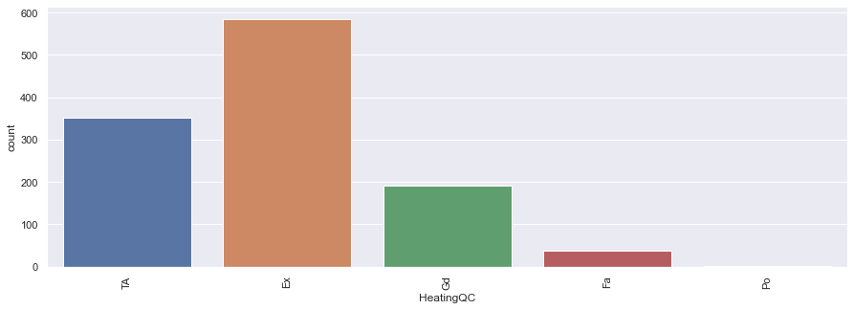
Visualization

Slide 32
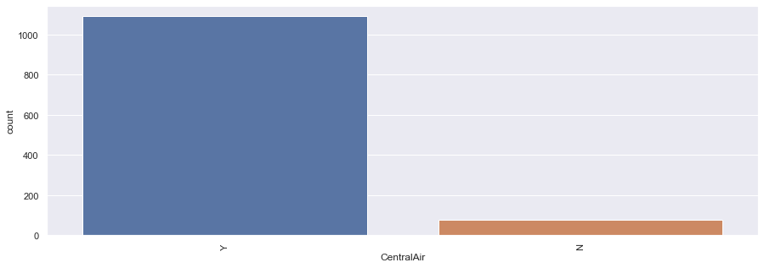
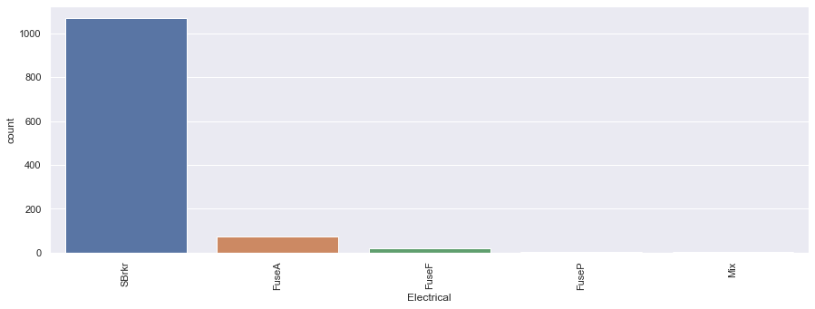
Visualization

Slide 33
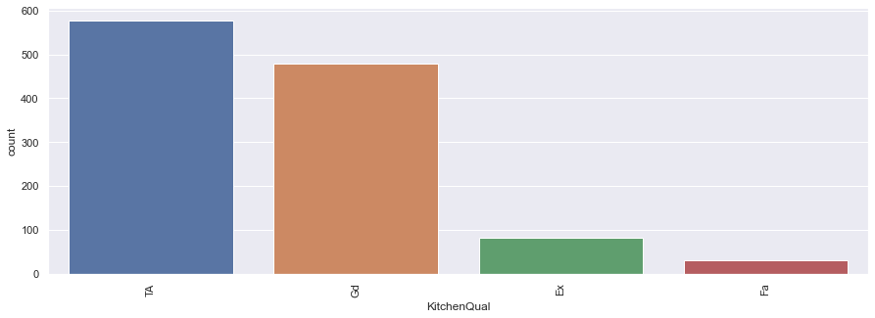
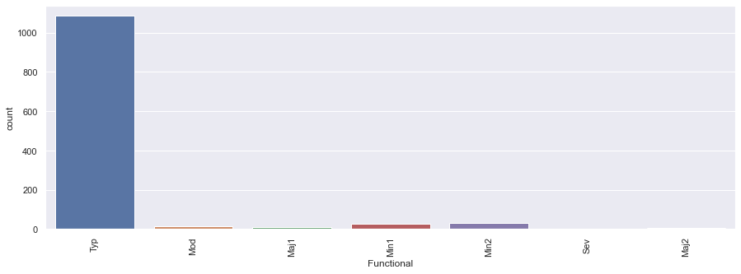
Visualization

Slide 34
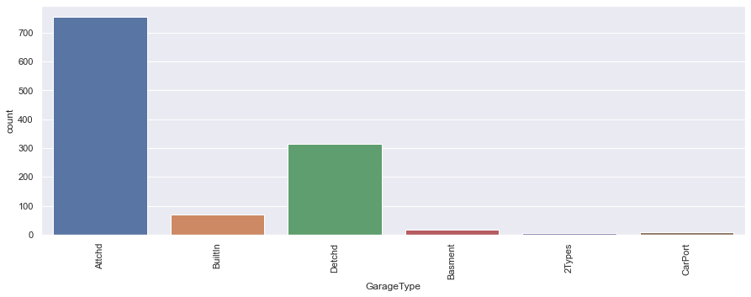
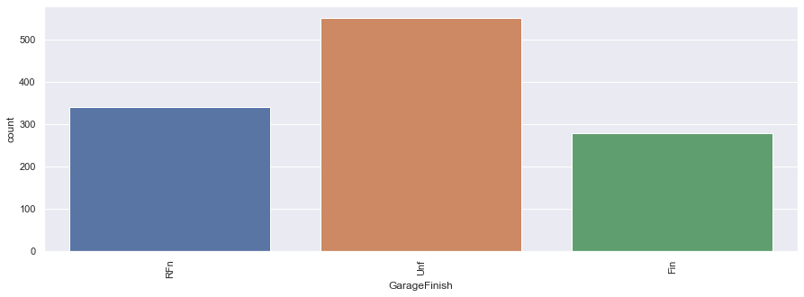
Visualization

Slide 35


Visualization

Slide 36


Visualization

Slide 37


Visualization

Slide 38


Visualization

Slide 39


Visualization

Slide 40


Visualization

Slide 41


Visualization

Slide 42


Visualization

Slide 43


Visualization

Slide 44


Visualization

Slide 45


Visualization

Slide 46


Visualization

Slide 47
Visualization

Slide 48


Bivariate Analysis
As maximum vehicle registration month is jan, it may be because of new year month. Accordingly one can apply some special offer in this month for increase sell of vehicle

Slide 49


Bivariate Analysis
As maximum vehicle registration month is jan, it may be because of new year month. Accordingly one can apply some special offer in this month for increase sell of vehicle

Slide 50


Bivariate Analysis
As maximum vehicle registration month is jan, it may be because of new year month. Accordingly one can apply some special offer in this month for increase sell of vehicle

Slide 51


Bivariate Analysis
As maximum vehicle registration month is jan, it may be because of new year month. Accordingly one can apply some special offer in this month for increase sell of vehicle

Slide 52


Bivariate Analysis
As maximum vehicle registration month is jan, it may be because of new year month. Accordingly one can apply some special offer in this month for increase sell of vehicle

Slide 53


Bivariate Analysis
As maximum vehicle registration month is jan, it may be because of new year month. Accordingly one can apply some special offer in this month for increase sell of vehicle

Slide 54


Bivariate Analysis
As maximum vehicle registration month is jan, it may be because of new year month. Accordingly one can apply some special offer in this month for increase sell of vehicle

Slide 55


Bivariate Analysis
As maximum vehicle registration month is jan, it may be because of new year month. Accordingly one can apply some special offer in this month for increase sell of vehicle

Slide 56


Bivariate Analysis
As maximum vehicle registration month is jan, it may be because of new year month. Accordingly one can apply some special offer in this month for increase sell of vehicle

Slide 57


Bivariate Analysis
As maximum vehicle registration month is jan, it may be because of new year month. Accordingly one can apply some special offer in this month for increase sell of vehicle

Slide 58


Bivariate Analysis
As maximum vehicle registration month is jan, it may be because of new year month. Accordingly one can apply some special offer in this month for increase sell of vehicle

Slide 59


Bivariate Analysis
As maximum vehicle registration month is jan, it may be because of new year month. Accordingly one can apply some special offer in this month for increase sell of vehicle

Slide 60


Bivariate Analysis
As maximum vehicle registration month is jan, it may be because of new year month. Accordingly one can apply some special offer in this month for increase sell of vehicle

Slide 61


Bivariate Analysis
As maximum vehicle registration month is jan, it may be because of new year month. Accordingly one can apply some special offer in this month for increase sell of vehicle

Slide 62


Bivariate Analysis
As maximum vehicle registration month is jan, it may be because of new year month. Accordingly one can apply some special offer in this month for increase sell of vehicle

Slide 63


Bivariate Analysis
As maximum vehicle registration month is jan, it may be because of new year month. Accordingly one can apply some special offer in this month for increase sell of vehicle

Slide 64


Bivariate Analysis
As maximum vehicle registration month is jan, it may be because of new year month. Accordingly one can apply some special offer in this month for increase sell of vehicle

Slide 65

Bivariate Analysis
As maximum vehicle registration month is jan, it may be because of new year month. Accordingly one can apply some special offer in this month for increase sell of vehicle

Slide 66


Bivariate Analysis
As maximum vehicle registration month is jan, it may be because of new year month. Accordingly one can apply some special offer in this month for increase sell of vehicle

Slide 67


Bivariate Analysis
As maximum vehicle registration month is jan, it may be because of new year month. Accordingly one can apply some special offer in this month for increase sell of vehicle

Slide 68


Bivariate Analysis
As maximum vehicle registration month is jan, it may be because of new year month. Accordingly one can apply some special offer in this month for increase sell of vehicle

Slide 69

Correlation of columns
,,,

Slide 70

Describe Dataset
..

Slide 71
Pair Plot of Dataset

Slide 72


Applied Encoding
Ordinal Encoding is used for feature columns, therefore, here I have applied ordinal encoding to the feature column of the dataset

Slide 73

Impact of Target variable
Purchase year positively impacting prizes whereas, transmission is negatively impacting (Manual varient is of less prize as compare to Automatic one)

Slide 74


Outliers not remove due to heavy loss
Both outliers removing techniques is giving high loss of data, therefore, I have word on dataset without removing outliers

Slide 75

Separating data into x and y form
After separating, the dataset into x and y form, we are having 10 feature columns and 1 target column (prize)

Slide 76

Removing Skewness
Applied square root transformation technique for removing skewness of ‘Kilometer’ column

Slide 77

Multicollinearity
We have to check for only Kilometer column, and for this column VIF value is in acceptable range.
Every column is showing VIF value under acceptable range,
Hence, dataset is is not having Multicolinearity

Slide 78

Applied Standard Scaling
Just one step before of machine learning, this scaling is applied to make sure, equal weightage of each column should be occur during machine learning.

Slide 79

Machine learning
These libraries used for building model of machine learning

Slide 80

Linear Regression model
This model is having very less accuracy of model and having very difference between cv and accuracy of model

Slide 81

Decision Tree Regressor Model
By applying this model, getting overfitted model, as its traing accuracy is higher than testing accuracy
Training Accuracy > Testing Accuracy

Slide 82

kNeighbors Regressor Model
This model is also giving overfitted model, and also having very difference in cv score value and accuracy value

Slide 83

Applied Bagging and Boosting techniques
Bagging and Boosting techniques are applied on the dataset because normal alogorithm was not giving enough result or good result

Slide 84

Random Forest regressor model
Having difference in accuracy of training and testing dataset, not much but having,
Also having high difference between cv and Accuracy of model

Slide 85

Adaboostregressor model
ML_Model function is created for smooth operation of machine learning
Logistic Model performance

Slide 86


Xgboost regressor model
This is model is giving good resule but giving over fitted model

Slide 87

Gradient Boosting Regressor
This model is giving good result as it not having much difference in accuracy of training and testing dataset
And also not having high cv value and accuracy difference

Slide 88

Ensemble Technique of GradientboostingClassifier
‘parameter’ these are the parameters which have to be applied on given model and then have to choose best one.
GridSearchCV will help in that

Slide 89

Ensemble Technique of GradientboostingClassifier
Found best parameter and applied passed those parameter with GradientBoosting Algorithm to get best results.

Slide 90

These passed parameters have increase accuracy and cv value of Gradient boost
Hence, this model selected as final model for deployment.

Slide 91

Final Model Performance
jjjj

Slide 92


Performance Graph
Graph for model performance
As model is giving 90 % accuracy , therefore, we points are divert from the actual value

Slide 93

Deploy and load model
Deployed model by using pickle library of python
After deploying the model same model imported and checked accuracy of that same model and found model is giving 0.90 accuracy as previous.
Means deploy process is successfully executed

Slide 94


Conclusion
One dataframe is created by the name “conclusion”, in this dataframe both (predicted and acutal ) values will be imputed.
By this dataframe one can see the difference between actual and predicted value

Slide 95

Conclusion
Comparing some value of actual dataset with predicted value by model

Slide 96


Prediction for testing dataset
…

Slide 97
Thanks you

